Slide 1
A Review of Transportation and Supply Chain Issues, Remedies, and Solutions

Slide 2
Agenda:
The Current New Supply Chain Landscape – Trends and Predictions
Lessons Learned – Post Covid
Making Sense of What This Means For Companies and Careers
01
04
Where Are We At Today
A Supply Chain Quiz
02
05
Making Sense of What This Means For Shipers
Solutions: Savings Impact and Benefits of an Outcome-Based Mindset
03
06
Notes:
Chad will take this slide

Slide 3
LESSONS LEARNED – LIVING IN A POST COVID WORLD
Supply chains are volatile as ever – and will continue to be well into the future
In a sea of volatility, having and working your plan is essential. No plan = Plan to fail
Scarcity has made C-Level executives aware of the “Economic Value” of supply chains
Having “Real Time” data and understanding that data is critically important in managing through cycles
Scenario planning that assesses the impact of future events can be a lifeboat
Managing from within and communicating upstream is essential

Slide 4
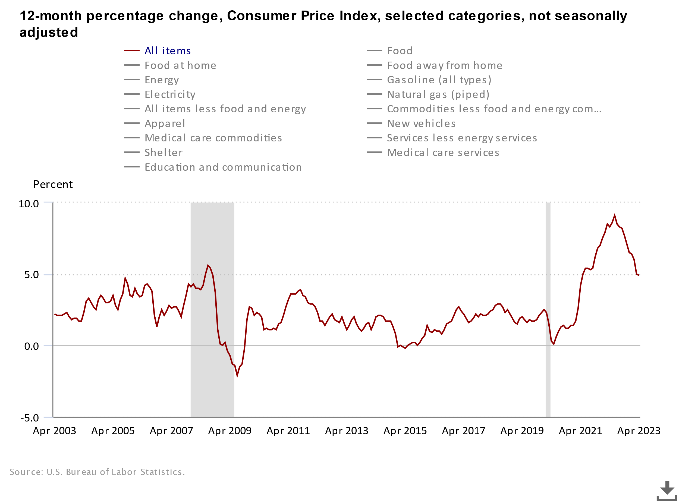
OVERALL MARKET OUTLOOK
We continue to see mixed signals in the economy.
Unemployment rate of 3.4% reported in April
Inflation dropped to 4.9%
Greater demand for air travel
Decreased demand for goods

Slide 5
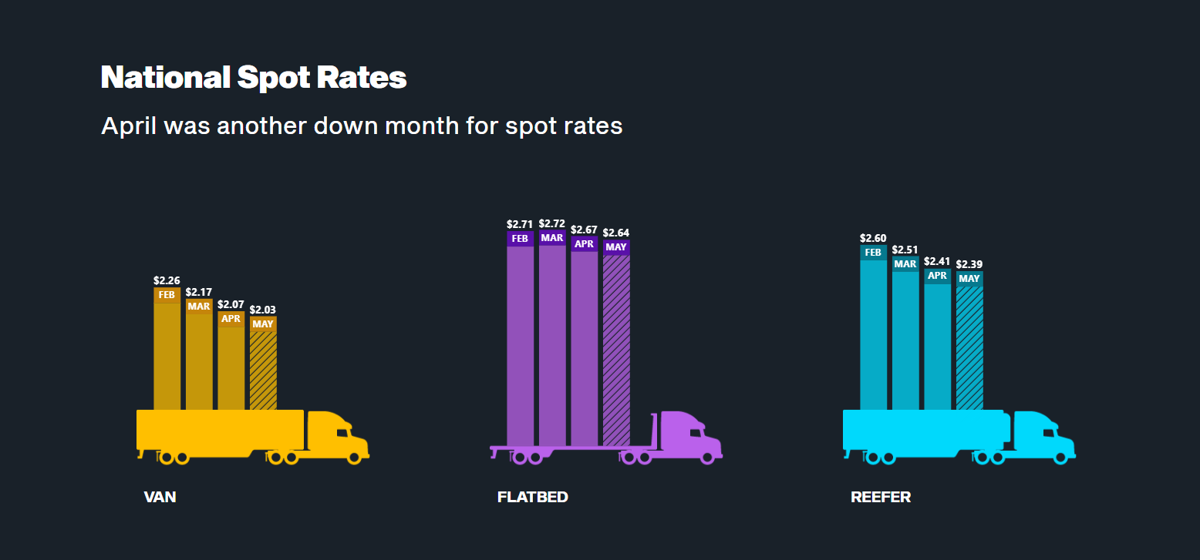
TRUCKLOAD – SPOT RATES STILL IN DECLINE
Graphs from Don
Source: DAT Trendlines

Slide 6
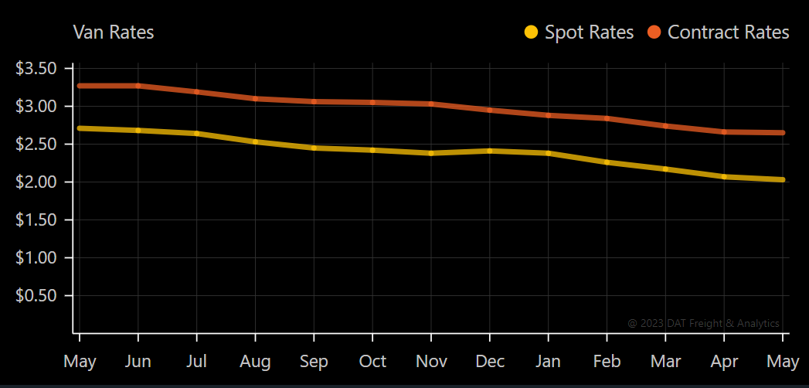
TRUCKLOAD – SPOT VS CONTRACT MARKET INVERSION CONTINUES
Source: DAT Trendlines

Slide 7
TRUCKLOAD MARKET – COMPRESSION OF CYCLES
We are in a freight recession.
- Shelly Simpson, President, JB Hunt - JB Hunt
After big rate increases in 2021 and 2022, Shippers getting relief in 2023 but important issues remain.
Higher embedded cost structures
Inflationary Costs for the foreseeable future
Variability of supply and demand
Lack of drivers
Lingering COVID-related issues affecting Warehouse / DC capacity
Legislative concerns (e.g.AB 5)

Slide 8
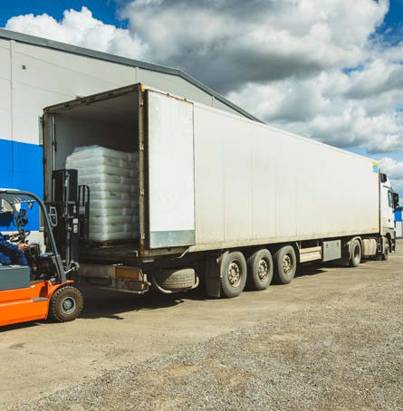
LTL
Summer of Teamsters
ABF, TForce, Yellow
What Matters To Your LTL Carriers
How does freight fit in carrier’s network?
What are the critical issues affecting my carriers?
What issues are carriers anticipating in the next 6-12 months?

Slide 9
PARCEL
Summer of Teamsters continued
Contract negotiations between UPS and Teamsters covering about 340,000 U.S. employees. Contract ends July 31
FedEx Restructuring
Transport Topics reported Fed Ex initiating a $4 billion cost-cutting initiative combining ground, air and other operations by June 2024.
Over 14 months, move will ultimately consolidate FedEx Express, Ground, Services and other FedEx OpCO’s into Federal Express Corp.
LTL operations under FedEx Freight will remain separate

Slide 10
RAIL & INTERMODAL
Impact of Rail safety bills introduced in Congress.
YTD volumes down overall for the first 22 weeks of 2023:
After a two-year long review STB approves Canadian Pacific’s acquisition of Kansas City Southern.

Slide 11
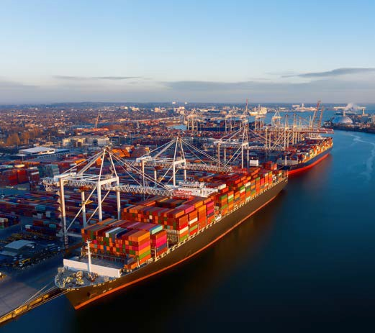
OCEAN – It’s A Mess! End of Story
After Historically High Rates, Rates now at pre-pandemic levels.
Volumes fell at most ports – especially West Coast Ports during the first quarter of 2023.
Ongoing negotiations at West Coast ports for the contract with ILWU causing disruptions
More capacity coming online in a market that is likely to remain soft through 2024

Slide 12
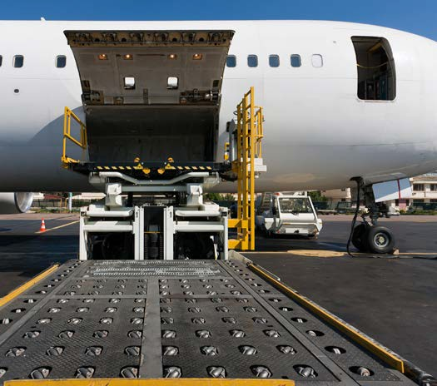
AIR
Air cargo demand has decreased in the past year while capacity has expanded.
FedEx reducing air network over the next several years in line with its cost cutting initiatives

Slide 13
Making Sense of What This Means for the Shippers
Accept that The Rules of the Game have changed
Smart Shippers are looking at these facts and analyzing the “How will this impact my supply chain questions?
Understand the correlation between transportation and SC issues and impact on your Balance Sheet.
In a Sea of Volatility communicating upstream is important!
Remember the Golden Rule. Figure out who owns the gold – and speak their language

Slide 14
STRATEGIES TO CONSIDER IN A SEA OF VOLATILITY
Use Carrier Yield Test to Understand a carrier’s Cost-to-Serve (CTS) before sourcing events.
Use of rolling Geocentric “Micro Bids” to align TL / LTL freight with carrier networks
Quantifying the potential financial impact of changes in supply chain processes affecting the procurement, operations and sales areas.
Conduct a Risk Assessment or Stress Test your contingency plans.

Slide 15
Sourcing During Periods of High Growth—or—High Volatility?
Be intentional and strategic when sourcing for Transportation And The 3 C’s
High growth brings poor visibility to an accurate demand forecast. This creates Demand Variability.
Frequent Supply Chain disruptions bring volatility and uncertainty and chaos to inbound supply. We call this volatility Supply Variability.
When sourcing transportation during these periods you must remember the prioritization of the 3 C’s:
Capacity
Consistency
Costs

Slide 16
What This Means For Companies and Careers?

Slide 17
Supply chain & logistics have become headlines rather than just line items in a P&L.
Freight Market Update – Second Quarter 2023
https://info.tranzact.com/q2-2023-freight-market-update
Gary Shilling Economic Update Interview
https://info.tranzact.com/interview-with-gary-shilling-economic-review-and-forecast
What the Board Wants to Know About Your Supply Chain Webinar
https://info.tranzact.com/webinar-recording-03-09-23
TranzAct Resource Center
https://www.tranzact.com/resources
17

Slide 18
Companies don’t compete. Supply chains compete.
In 2022, a study by Alix Partners reported that 72% of CEOs were worried they would lose their job.
“The C-Suite is a bundle of nerves this winter. A recent survey by Alix Partners showed that 72% of chief executive officers are worried about losing their jobs because of business disruptions, tracking closely with the 94% of bosses who say their corporate models need to be overhauled within three years.”
“Falling right behind the number one concern of permanent labor shortages, and before the continuation of supply chain disruptions (69%) was worry about CEOs losing their jobs.”
Is your supply chain an asset or a liability?

Slide 19
Supply Chain Management
Process Relationships
Forecasting
PSA creation
Customer satisfaction surveys
Complaint resolution
Order management
Account management
Stockability
Order management
Inventory, transportation and network management
Lead time determination
Receiving
Customer satisfaction surveys
Lead times, promise dates
Product quality
<
Customer
Relationship
Management
Logistics Fulfillment Management
Lead user input
Customer inspired innovation
Commercialization plans
New product introduction plans & execution
Contract manufacturing products
Receiving
Transportation and network management
Import/export management
<
Manufacturing/Supply
<
PLC Management-SKU
Rationalization
Procurement
Data package
Mfg capability development
Manufacturing specifications
In process and final products testing
<
G&S contract management
Supplier management
Product specs & quality
Material forecasts
Receiving, replenishment
Chemical tracking
Raw material specs
New supplier selection
New product demand forecast
Lead times
Chemical/Haz Mat tracking
Goods/services categorization

Slide 20
How did Supply Chains get broken so quickly?
Covid exposed the impact of average-to-mediocre Supply Chains .
When chaos collides with confusion, business as usual goes out the door!
20

Slide 21
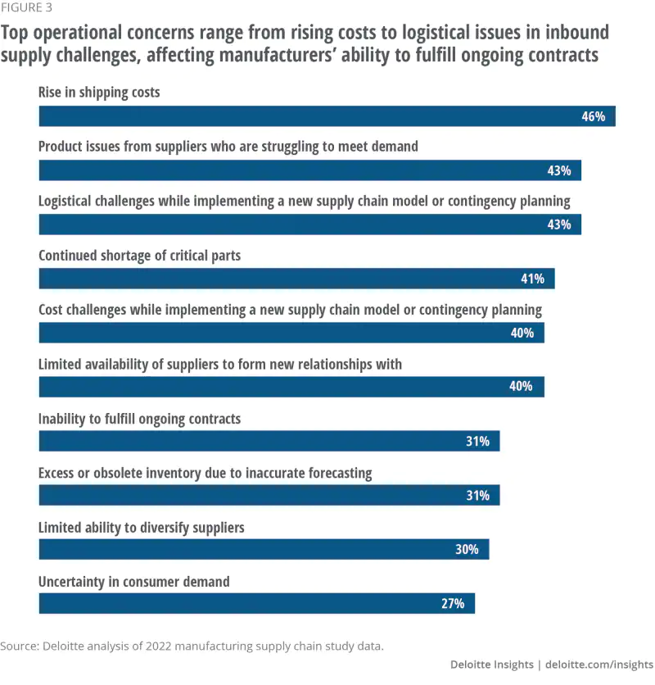
Notes:
Ursula

Slide 22
Where is your company on the Supply Chain Spectrum?
The Supply Chain Spectrum encompasses activities associated with:
Procurement / Suppliers & Inventory Strategies / Sales / Customers
Finance / Operational Processes / IT - ERP Systems
Inefficient
World Class
Reactive
Tactical
Siloed
Proactive
Strategic
Holistic
1
2
3
4
5
22
Notes:
Chad

Slide 23
Time for a Short SC Quiz
Why it Matters:
The 1 Day/1% Factor
Question # 1
What Is The Value Of Your
Supply Chain?
Company Sales * 12% (or 20%) =
Total Value of Your Supply Chain Costs
Question # 2
What Is 1% / 1 Day
Worth To Your Company

Slide 24
Solutions - Focus on Outcomes
How do we save 8-20% by moving up the Supply Chain Spectrum?
Current State
Future
State
Inefficient
World Class
Reactive
Tactical
Siloed
Proactive
Strategic
Holistic
1
2
3
4
5
Moving up the Supply Chain Spectrum can yield a savings of
8-20% and earnings that are equal to 1% of a company’s sales.
What does this mean for your company?
Company Sales * 12% * 10% = Potential Supply Chain Savings
24
Notes:
Chad

Slide 25
Opportunities: The Holistic MRI Road Map
With Associated ROI
Strategically-Incremental Method
Outsource
Freight
Audit & Payment
Stratify Customers
& Service
Levels
Optimize
Outbound
Deliveries
Correct Fulfillment Allocation
Procure
Optimum
Rates
Reduce
Material
Transfers
Key Issues:
Rogue Spending
Duplicates
No Data/History
Accurate Accrual/FS Reporting
Fixed Routes
Frequency
Technology
Split Shipments
Visibility
Service Commitments
Rates & Lanes
Common Tariff
Volume Incentive
One Grouping
Next Day Service
“Normal” Service Level
Forecast
Inventory
Location
History
Opportunity:
$125,000
$650,000
$500,000
$350,000
$200,000
$750,000
Notes:
Chad will take this slide

Slide 26
What is our rank on the Supply Chain Spectrum?
Where do we want to be on the SC Spectrum?
The DNA Issue: Can we shift from being transactional to being strategic?
What will it take to move up the spectrum to get the results that we want?
Are we truly committed to achieving the real ROI on this investment?
Be Outcome Oriented.
Outcome-Based Dialogues Require Tough Questions About Your Supply Chain Capabilities

Slide 27
Moving up the Supply Chain Spectrum requires:
01
A Top Down Commitment
There are critical elements that cannot be delegated.
02
Resources (Tools, Technology, People)
Great supply chains cannot be built on the cheap.
03
Experience and Expertise
Make sure the resources are invested in the right areas, addressing the right issues.
Turning your Supply Chain from a Liability to a Competitive Asset

Slide 28
Mutually Beneficial Outcomes
We Win Together!
01
Predictability
You can’t have lean without a predictable supply chain.
02
Dependability and Reliability
We know who to call and are confident in their ability to consistently produce on our behalf.
03
Accountability & Savings
We have a strategy and know who is responsible for achieving desired outcomes and savings.

